Slide 1
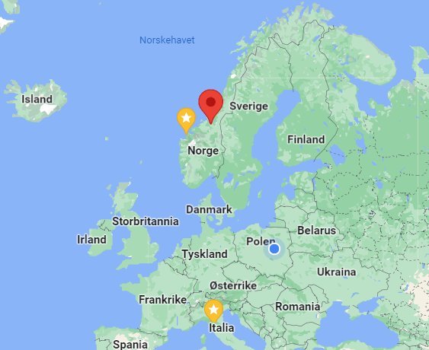
Social entrepreneurship
- Education program and perspectives
Karl Johan Johansen and roger Santokhie

Slide 2

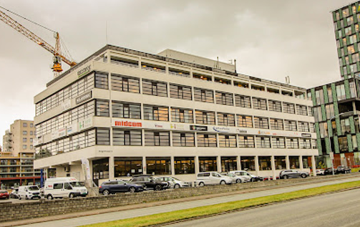

Slide 3
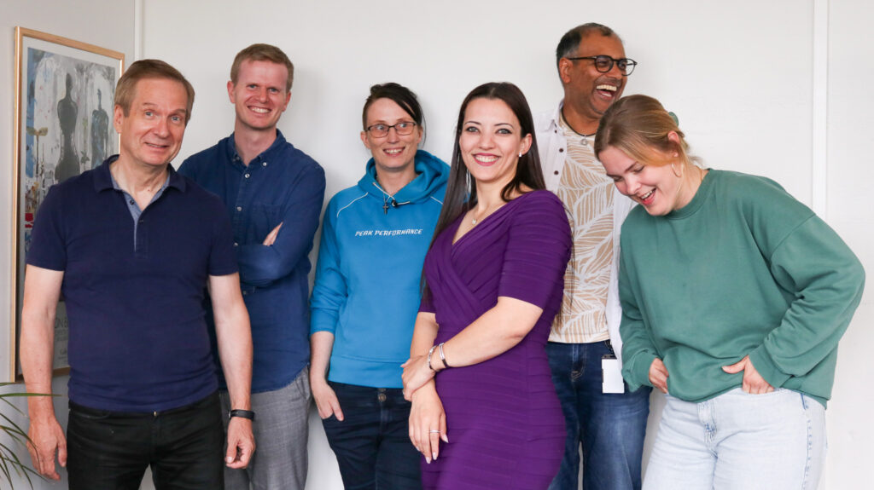
Vocational program in Social Entrepreneurship
Vocational means more practical training= 50% of the education is practice
3 theoretical topics about identy needs, professional work with different tools, organization, economy, ecosystem and barriers
2 practice periode of 12x2=24 weeks
60 university credits

Slide 4
Definition of a Social entrepreneur
“A Social entrepreneur work for social change in the cracks and gaps that exist between the state, the market and the voluntary community. A social entrepreneur recognizes a social problem and uses tools from the business world to help solve this problem. Success in social entrepreneurship is not measured in profit, but in how big a positive impact the business has”
Cf. Nordic Council of Ministers, 2011: Creativity, innovation and entrepreneurship in the education systems in the Nordics have an impact on society.

Slide 5
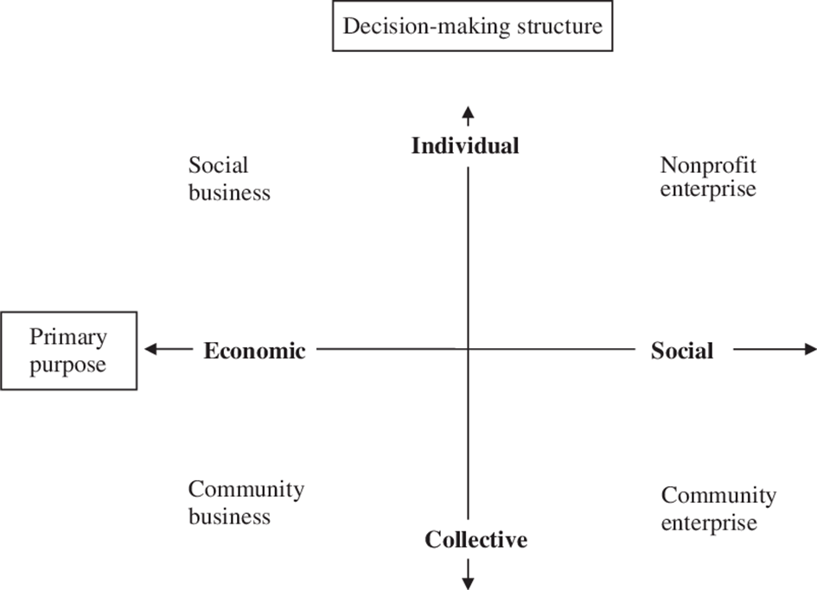
Types of social entrepreneurs

Slide 6
Four types of social entrepreneurs
Type A: Business-based activists Entrepreneurs who contribute to a common cause by selling products or services.
Type B: Social entrepreneurs Companies that do business with the aim of helping vulnerable groups.
Type C: Innovative associations Professional public organizations that use new methods to meet social needs.
Type D: Innovative/entrepreneurial social workers Solve specific social needs in new ways. Funding is based on either public or private support, or supplier agreements
(Cf. Monday Morning 2010).

Slide 7
Choice of business model

Slide 8
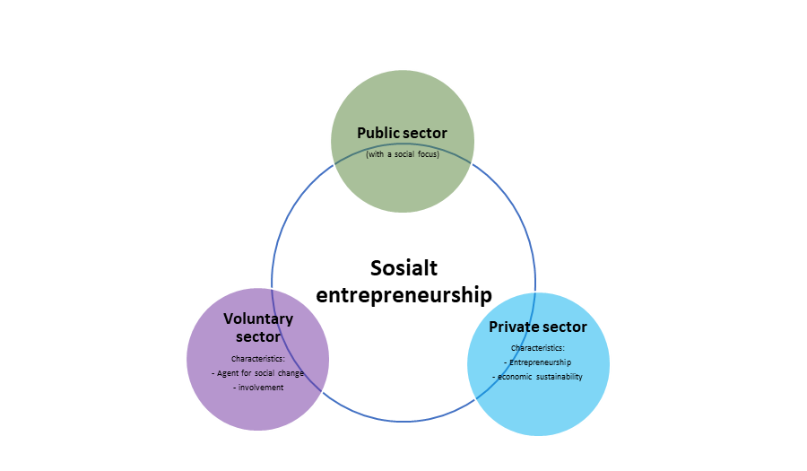
The relationship between the different sectors in society – Triple Helix – dimension/curve in space

Slide 9
Quadruple Helix

Slide 10
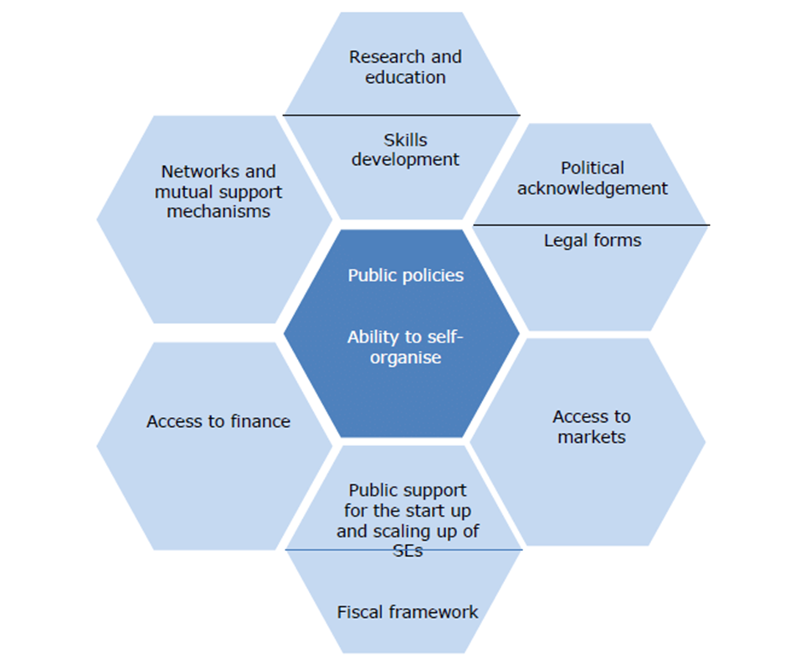
Ecosystem for social entrepreneurship

Slide 11

Many industries and organizational forms
Social entrepreneurial enterprises are spread over many fields and they have different organizational forms and models.
In relation to the usual statistical division of the business world, social entrepreneurs appear as a fragmented group.
(Kobro 2017, p. 33)
Company, NGO, Cooperative, Foundation, Hybrid,

Slide 12

Barriers
Research shows that:
There are a number of barriers and difficulties that seem to be obstacles to the growth of social entrepreneurship in the Norwegian welfare state; structural, legal and financial conditions, but also attitudinal/cultural conditions.
Findings also point to the social entrepreneurs themselves, that social entrepreneurs often have a little too simple and naive ideas about how social challenges can be solved.
(https://openarchive.usn.no/usn-xmlui/handle/11250/2463099)

Slide 13

In practice, dual competence is required
The entrepreneurial process is about discovering and exploiting a set of dual opportunities – both commercial and social.
Often it requires participation in networks/environments where the competence the social entrepreneur himself does not have is available.
Social capital is important

Slide 14

Mixed collaboration processes
Social entrepreneurs are often involved in Co-creation - Co-production
Logic, skills and competence from the private sector combined with volunteerism/idealism, life experiences in the field of social practice,
Law, economics and politics are mixed together in creative and constructive processes, with new and useful solutions as.
Social value is created in both process and result. Dignity, respect, empowerment and meaning are social values ​​that emerge in the process

Slide 15
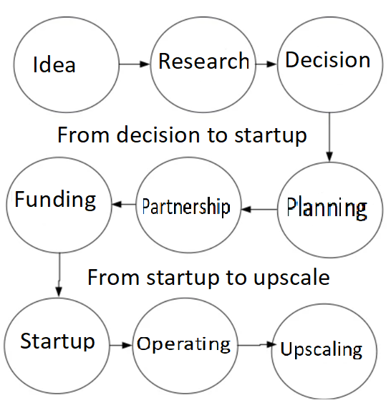
The development process step by step

Slide 16
Examples of social entrepreneurship
Powerfarm - Outdoor therapi
Someone AS - dementia care
Anthill - Social Care
More taste - Social integrasjon
Outdoor academy – Nature Knowlegde
Heidi hiker - Outdoor terapi
Fellow Hikers – Mental support
Deep Roots – Green production/integration

